Slide 1
Optimisation in my research
Jeremy Watson

Slide 2
Overview
My research has used optimisation in a number of ways:
Distributed optimisation and control algorithms for power systems (main focus today)
Linear Matrix Inequalities (LMIs) for control synthesis*
Optimal power-flow in unbalanced low-voltage distribution networks*
(*slides at the end if anyone is interested)

Slide 3
Distributed optimisation / control
Main idea:
each agent / device / system controls its own variables (typically state variables of that system which are also design variables of an optimisation problem)
by low band-width, distributed communication with other local agents, these variables are updated until the global optimisation problem is solved.
this can allow large-scale optimisation problems to be solved automatically by simple controllers at each device as opposed to solving the problem centrally at high computational cost and broadcasting the solution to each device.
already used (wide range of applications) in industry, although not especially common.
potential applications (mostly in the future) include coordination of UAVs, self-driving vehicle platoons, smart grid, etc.

Slide 4
Distributed optimization / control
Research areas:
Improving convergence rates and properties (e.g. ADMM is one of the best recent algorithms)
Coping with enforced dynamics in each agent. Agents typically have their own application-specific dynamics which may not be easy to control.
Cyber-security – what happens if one or more devices are adversely controlled or deliberating send false data?
Coping with time delays and/or noise in communication
Stochastic networks – i.e. random communication failures, etc. – what can the distributed
Hybrid approaches using some form of reinforcement learning as well.

Slide 5
Application to power systems
replace optimal power-flow and frequency control with distributed optimisation & control
each generator has a controller that guides its power setpoints to the (true) OPF setpoint, based on communication with neighbours.
not really needed in the power system of today, but potential for implementation in future grids / microgrids

Slide 6
Intro to distributed optimisation / control
Consider a separable cost function for a network of agents
Constraint: at steady-state, each agent must have the same value of the state variable (this is called a consensus problem). Typically this is something like a market price or (scaled) power output, etc.
i = agent i
x_{i} = state of agent i
V = set of agents
F_{i}(x_{i}) = cost function of agent i
Communication network matrix

Slide 7
Intro to distributed optimisation / control
KKT conditions for optimality
Guaranteed stability & optimality!!
Results also exist for cost functions which are not strictly convex, but not in all cases and not with the same simplicity

Slide 8
Primal-dual secondary frequency control with delays
(IEEE Trans. Automatic Control 2024)
Results (IEEE 39 system) with 20ms communication delays
Idea: transform the communicated variables to
allow noise resistance + delay robustness
Transformations
Traditional controller
Our proposed controller
Results (IEEE 39 system) with noisy measurements (SNR = 20dB)
Traditional controller
Our proposed controller

Slide 9
Case study
Distributed secondary control for hybrid AC/DC grids
(IEEE Trans. Control Systems 2021)
Idea: implement a similar form of distributed optimisation
on hybrid AC/DC power grids
Optimisation formulation
System dynamics
Traditional controller
Distributed Averaging
Proportional-Integral
Controller
Our proposed controller
Control + Optimisation
theory used to prove
stability and optimality

Slide 10
Linear Matrix Inequalities
State-of-the-art linear control techniques are usually based on Linear Matrix Inequalities (LMIs), where the control gains are the solution to a linear optimisation problem. Examples:
LQR (Riccati equations are LMIs)
Model predictive control
H-infinity, H2 control
Passivity-based control
Stability analysis
Further reading (if interested): https://web.stanford.edu/~boyd/lmibook/lmibook.pdf

Slide 11
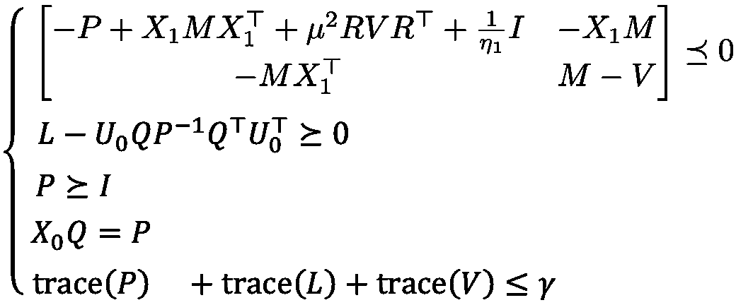
Scalable microgrid control
(IEEE Trans. Smart Grid 2021)
Data-driven control
(Trickett, PMAPS 2024)
Inverse optimal and passivity-based control
(Hallinan, IEEE CDC 2023)
Formulation
Formulation
Formulation
System
System
System
Performance
Performance
Performance

Slide 12
Unbalanced optimal power-flow
Results
Less computational expense
Back in 2017, optimal power-flow for unbalanced networks was mostly unexplored.
Published in IEEE Trans. Sustainable Energy.
Formulation
Case study
22% reduction in energy losses
Small approximation error
Convexified
constraints

